Slide 1
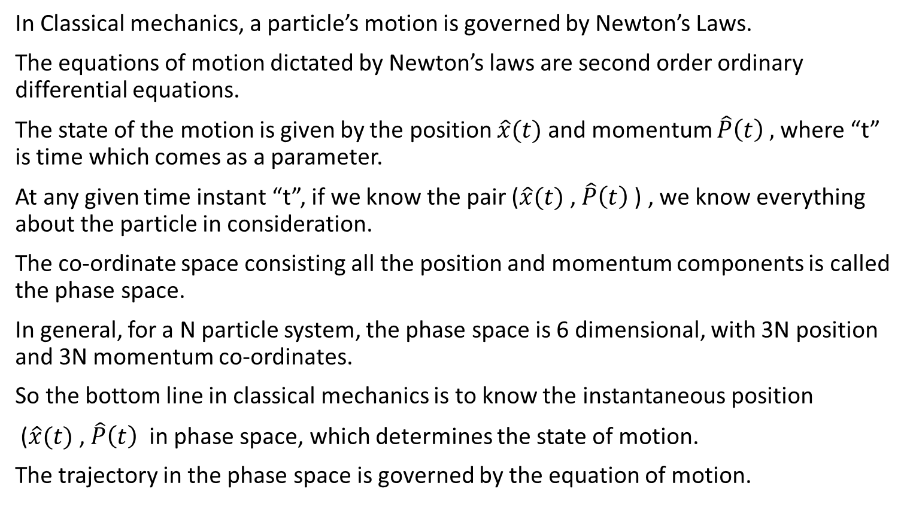
Lecture 2: Introduction to Hilbert space

Slide 2
Quantum Mechanics
In Quantum aa, the basic question remains the same: What is the state of motion ?
The state of motion cannot be determined by the point in phase space.
We have to consider uncertainty principle.
Position and momentum cannot be determined with perfect accuracy simultaneously.
Also the entity obeying quantum mechanics do not obey Newton’s Laws.
Therefore we need a new “space” and a new “Principles of motion”

Slide 3
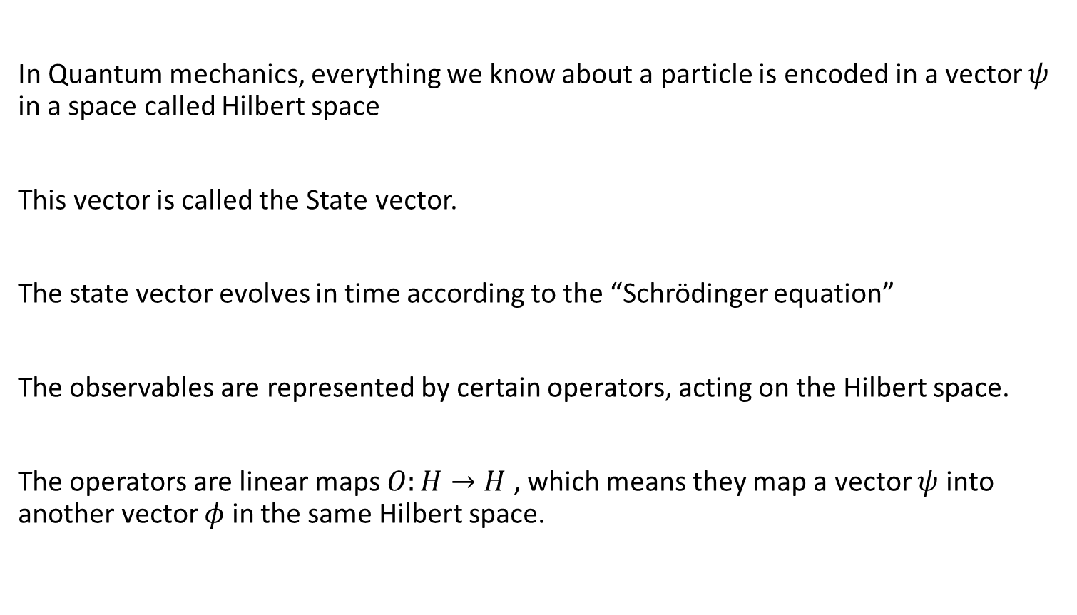
We need Hilbert space

Slide 4
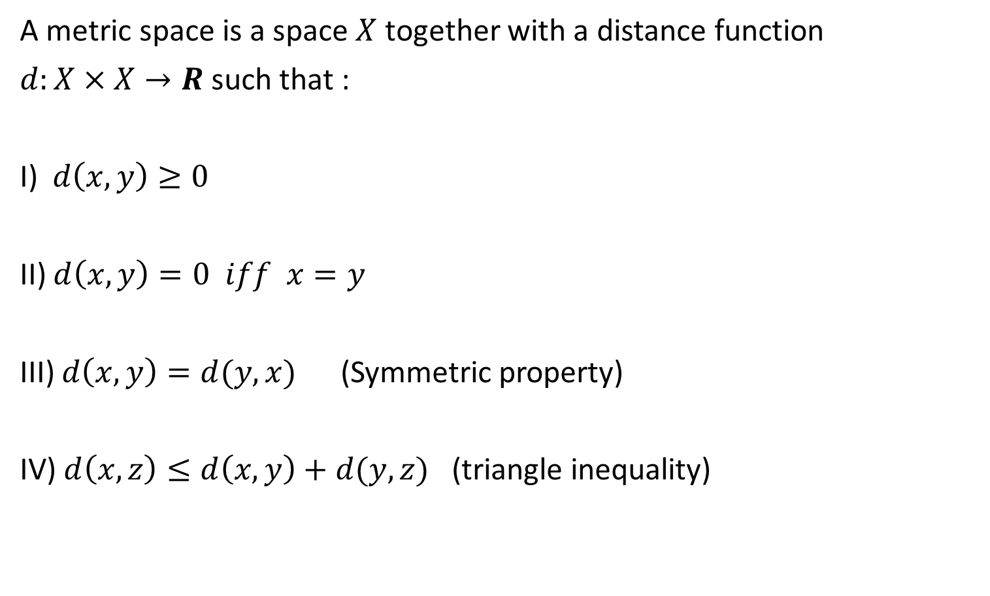
Metric Space

Slide 5
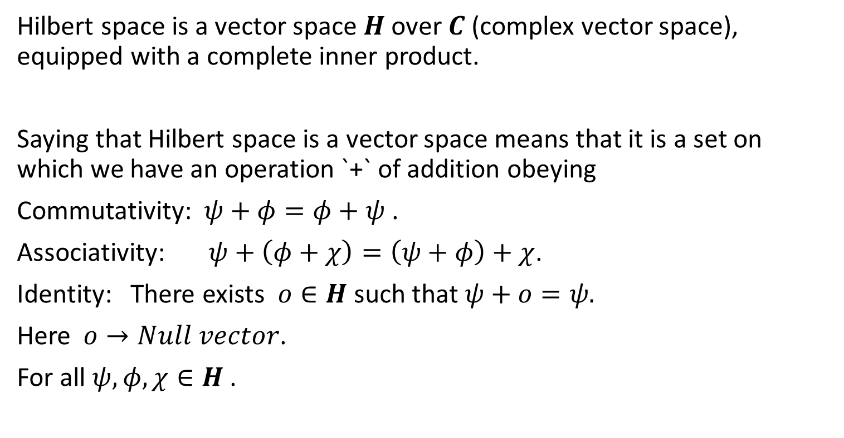
Hilbert Space

Slide 6
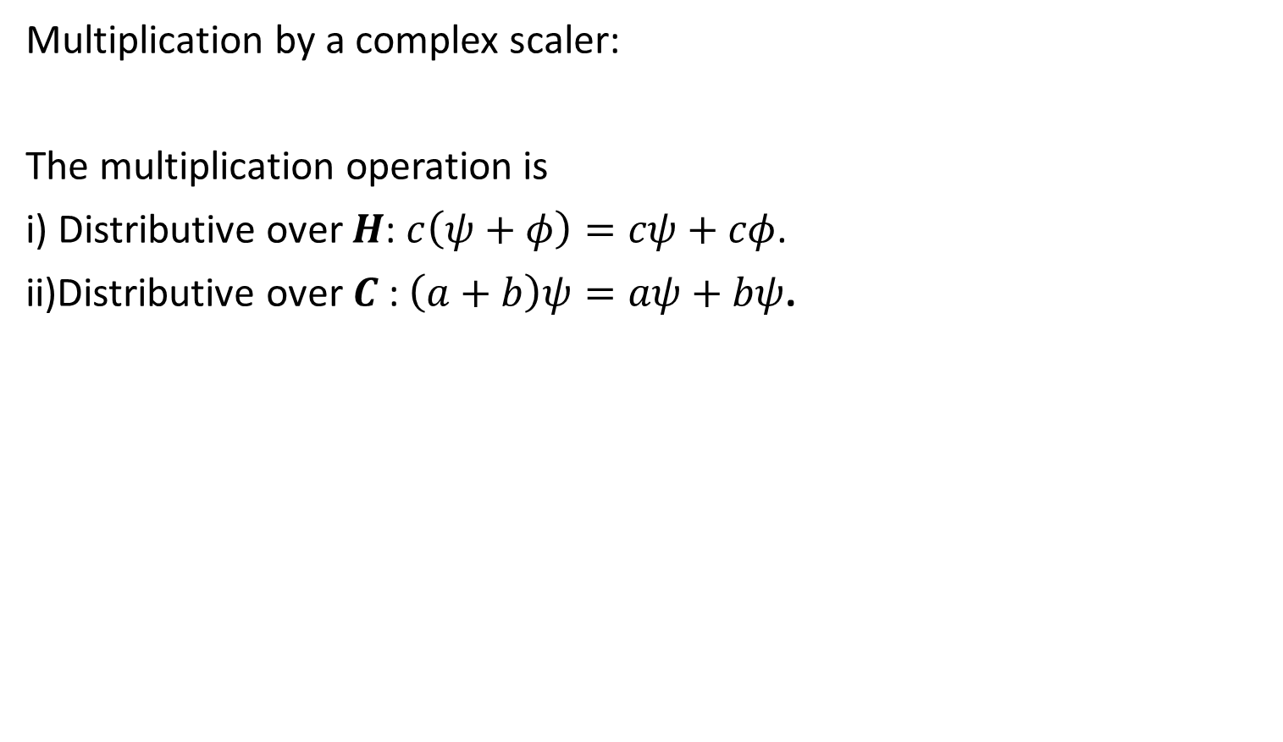

Slide 7
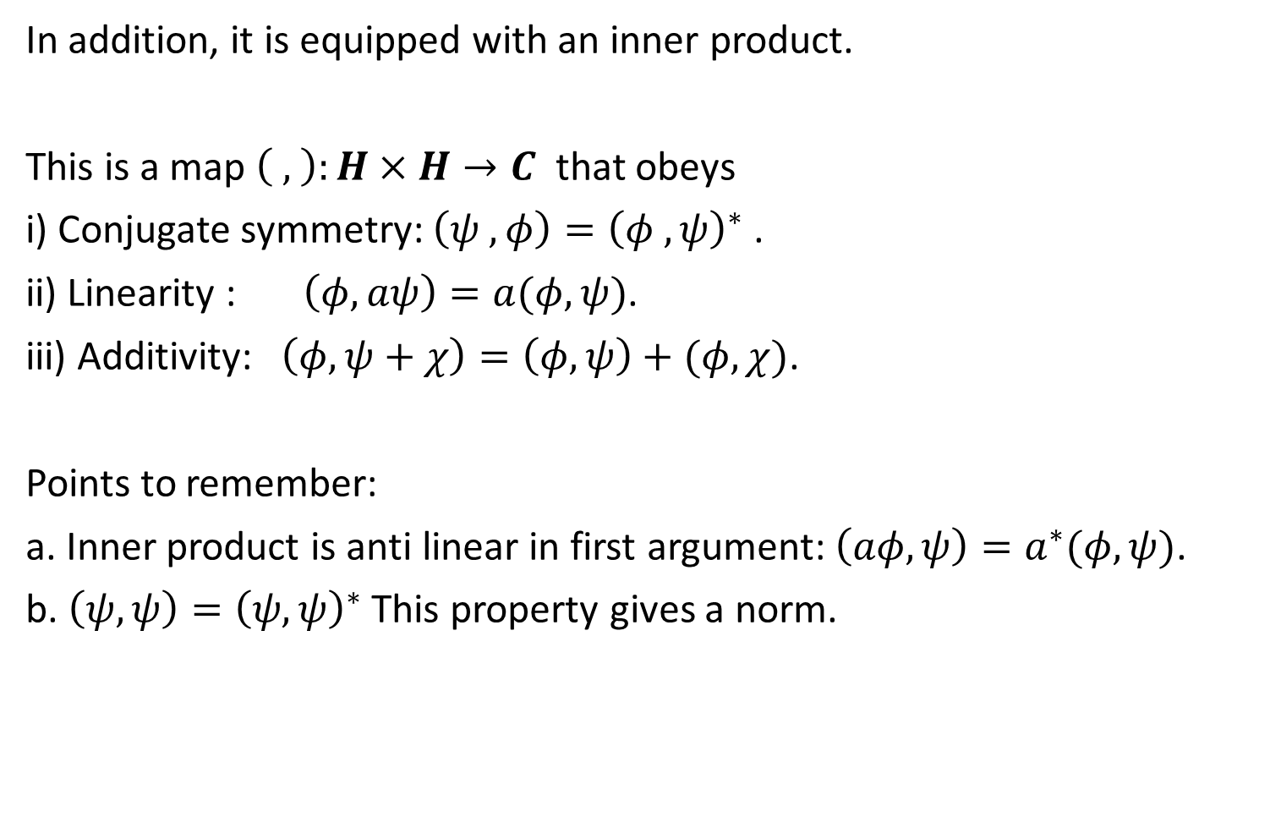

Slide 8
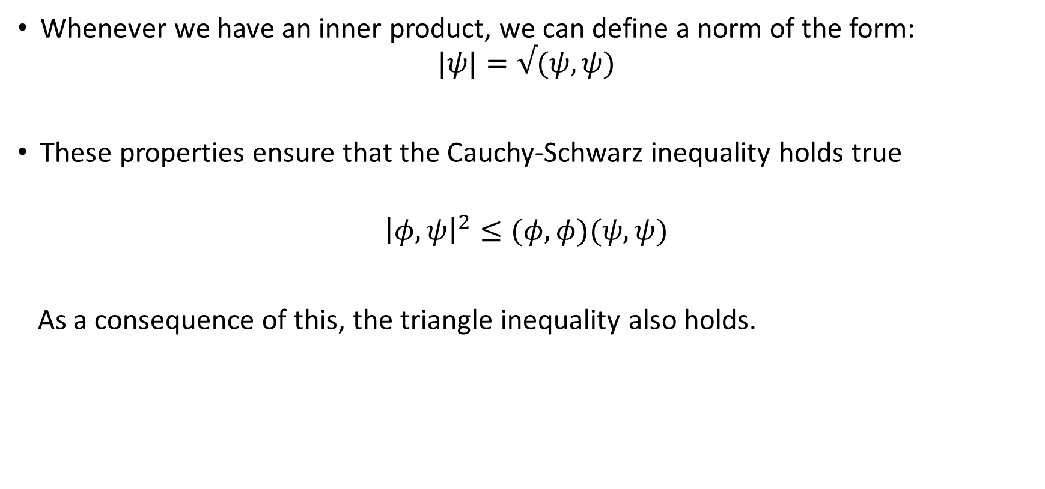
Norm

Slide 9
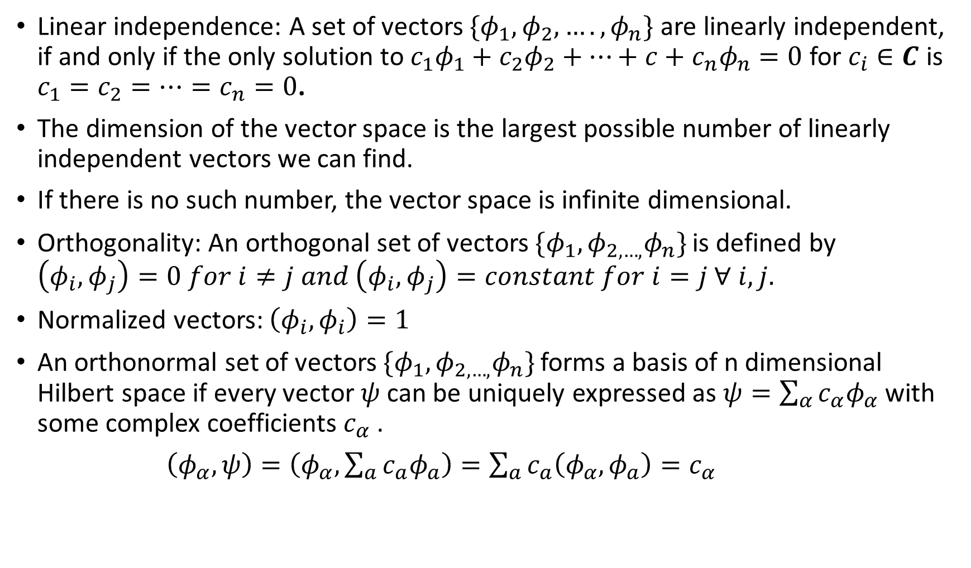

Slide 10
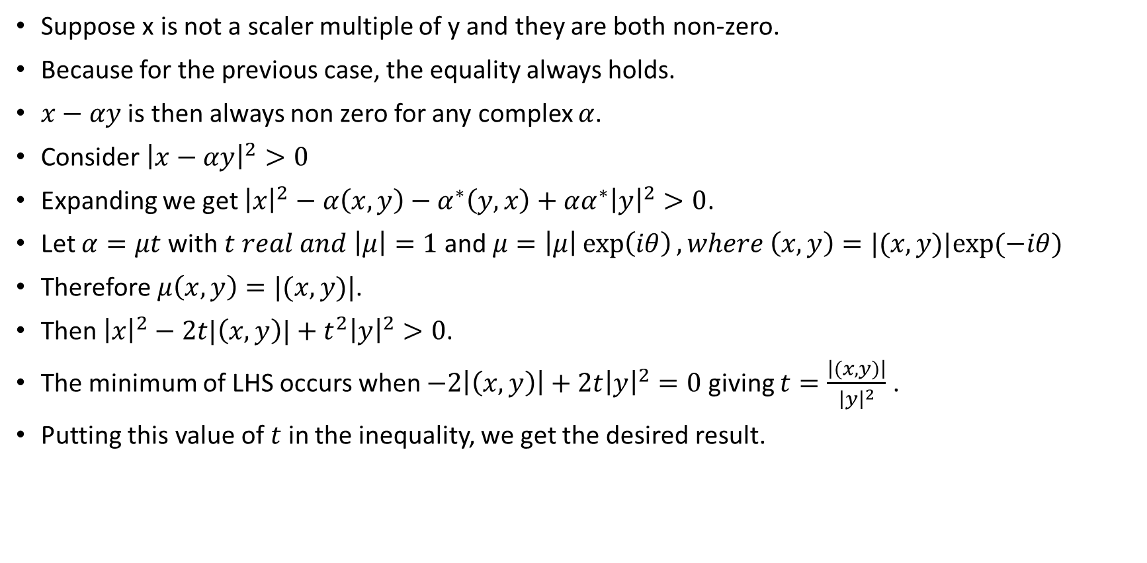
Cauchy-Schwarz inequality

Slide 11
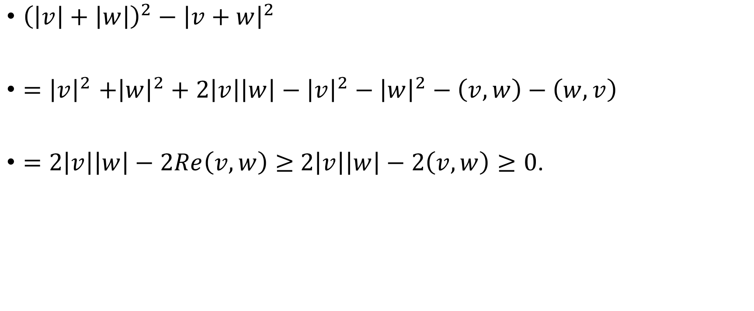
.

Slide 12
Consider Cartesian Co-ordinate system in three dimension.
Verify all the properties of a vector space
What will be the inner product ?
Verify the Cauchy-Schwarz inequality and Triangle inequality.

